Slide 1
Linear Data Structures
Static List (Array), Linked List, Double Linked List, Stack, Queue, Priority Queue

Slide 2
Array List
functions

Slide 3
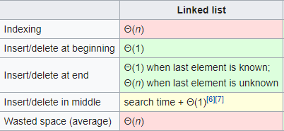
Linked List
functions

Slide 4
Array List vs Linked List

Slide 5
Double Linked List

Slide 6
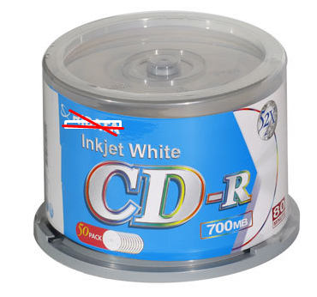
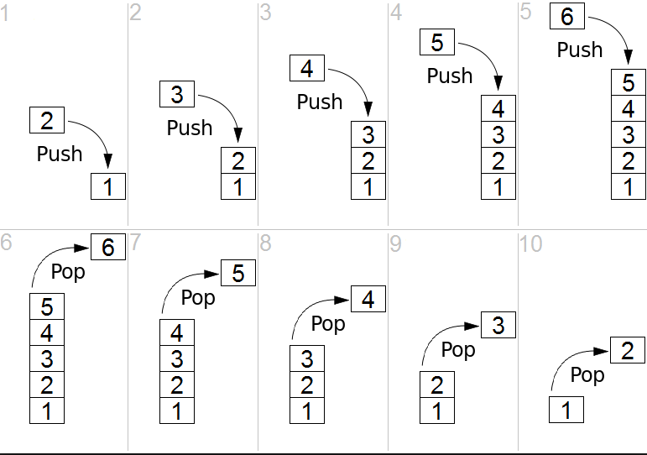
Stack
functions

Slide 7
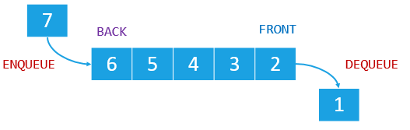
Queue
functions

Slide 8
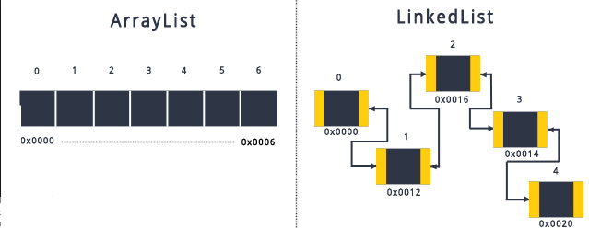

Slide 9
Questions

Slide 10
